Slide 1
Contemporary Moral Problems
SUM2014, M-F12:00-1:00, SAV 264
Instructor: Benjamin Hole
Office Hours: M-F1-1:15
Email: bvhole@uw.edu

Slide 2
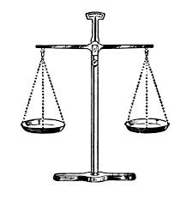
Agenda
Clicker Quiz
Timmons MPT
Overview
Start “6 essential ethical theories”

Slide 3
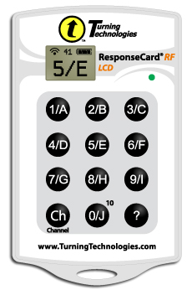
QUIZ
Please set your Turning Technology Clicker to channel 41
Press “Ch”, then “41”, then “Ch”

Slide 4
Is the following argument valid? “If the Vatican’s account of Natural Law Theory is true, then non-procreative sexual activities are morally impermissible. But the account of Natural Law Theory is false! So, non-procreative sexual activities are morally permissible.”
Yes
No

Slide 5
According to Timmons, in ethical theory, the terms “right” and “wrong” are used primarily to evaluate the morality of:
Persons
Actions
Consequences
Duties
Concrete Objects

Slide 6
According to Timmons, necessarily, if something is intrinsically good, then:
its value depends on its relationship to something else that is intrinsically good
its value depends on features that are inherent to it
it is an action that is morally right
it is also intrinsically value-neutral

Slide 7
Practice Reconstructing Arguments
Based on ethical intuitions

Slide 8
The rightness or wrongness of an action does not depend on its consequences.
Strongly Agree
Agree
Somewhat Agree
Neutral
Somewhat Disagree
Disagree
Strongly Disagree

Slide 9
It is morally wrong to make yourself an exception to a rule (e.g., cutting in line).
Strongly Agree
Agree
Somewhat Agree
Neutral
Somewhat Disagree
Disagree
Strongly Disagree

Slide 10
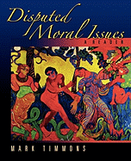

Timmons
“MORAL THEORY PRIMER”

Slide 11
Timmons
“in arguing for a particular position on the topic of, say, euthanasia, philosophers make their case by applying a moral theory to the practice of euthanasia” (2).

Slide 12
Timmons
Theory
Practice
“The theoretical aim of moral theory is to discover those underlying features of actions, persons, and other items of moral evaluation that make them right or wrong, good or bad and thus explain why such items have the moral properties they have. Features of this sort serve as moral criteria of the right and the good” (3-4).
“The practical aim of a moral theory is to offer practical guidance for how we might arrive at correct or justified moral verdicts about matters of moral concern – verdicts which we can then use to help guide choice” (4).

Slide 13
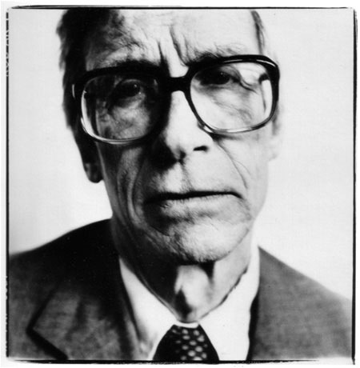
The Right (Duty) & The Good (Value)
“The two main concepts of ethics are those of the right and the good”
(Rawls, A Theory of Justice, 24).

Slide 14
Value Base Moral Theory
Duty Based Moral Theory
takes the good as primary (and derives the right from the good).
takes the right as primary (and derives the good from the right).

Slide 15
Would you turn the trolley?
Yes
No

Slide 16
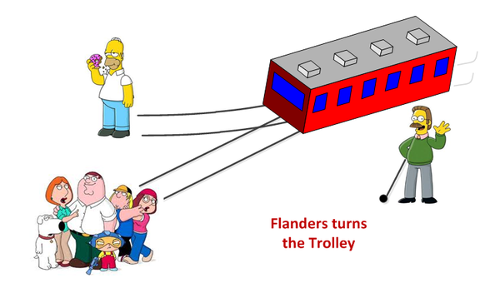
Trolley Problem

Slide 17
Value Base Moral Theory
Duty Based Moral Theory
takes the good as primary (and derives the right from the good).
takes the right as primary (and derives the good from the right).

Slide 18
Principles
“moral principles – very general moral statements that specify the conditions under which an action is right (or wrong) and something is intrinsically good (or bad)” (4).
Note: “if and only if (and because)”

Slide 19
There is an exception to every rule (or ethical principle).
Strongly Agree
Agree
Somewhat Agree
Neutral
Somewhat Disagree
Disagree
Strongly Disagree

Slide 20
Overview
“Six Essential”
Theories
Ethics by Authority
Consequentialism
Kantian Ethics
Natural Law Theory
Rights Based Moral Theory
Virtue Ethics
Prima Facie Duties
Divine Command Theory
Ethical Relativism

Slide 21
Preferred ethical theory
Consequentialism
Kantian Ethics
Natural Law Theory
Rights Based Moral Theory
Virtue Ethics
Prima Facie Duties
Divine Command Theory
Cultural Relativism

